Slide 1


Stop Hunger
Doubling farmers income
TM
Counter Malnutrition
Health Solutions
Caradora is registered trademark of Caradora Health Solutions Pvt. Ltd
Pollution Control
TM
Creating jobs and employment
REGISTERED OFFICE – Agra –Jaipur National Highway, 300, Uncha Nagla , Bahnera , Bharatpur, Rajasthan IN. 321001

Slide 2

Spirulina?
Spirulina is a blue-green algae (cyanobacteria) that can be consumed by humans and other animals.
And being cultivated worldwide to fight malnutrition & as a dietary supplement.
Gram per gram Spirulina has the highest nutrients than any other food in the world.

Slide 3

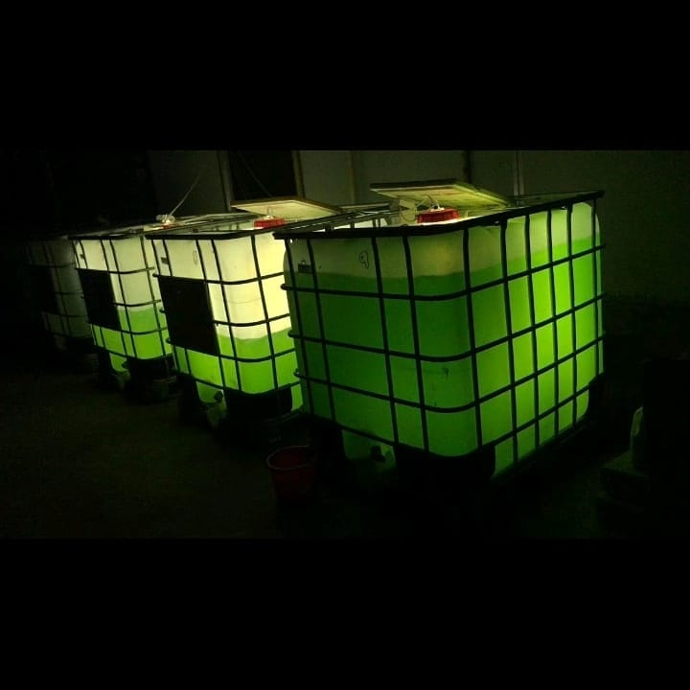
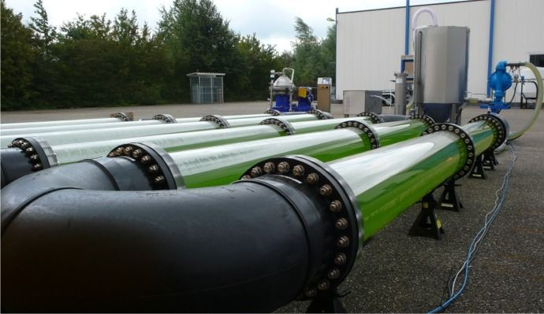
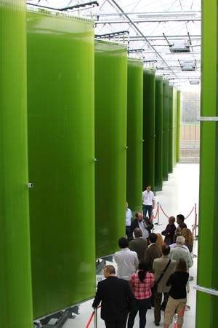
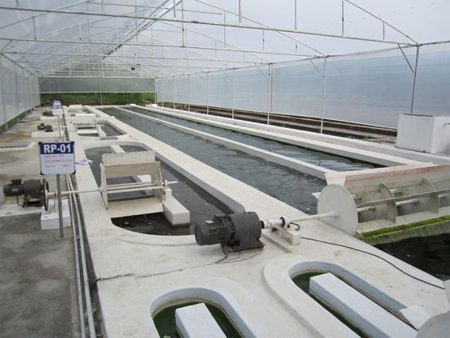
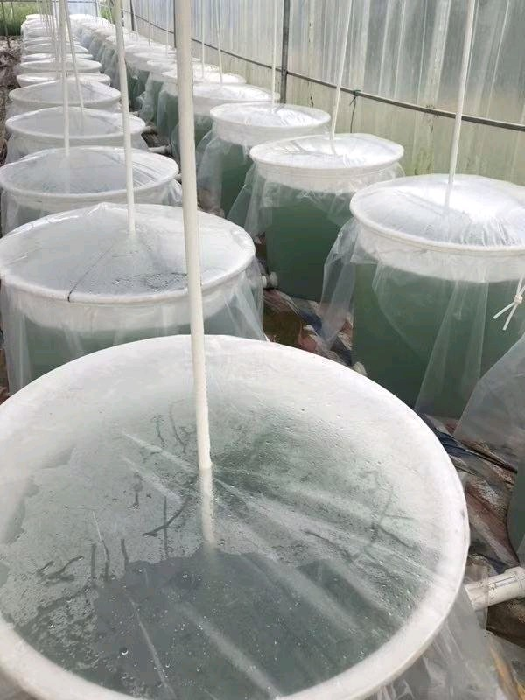
SPIRULINA is very much useful in BIOTECH industry

Slide 4
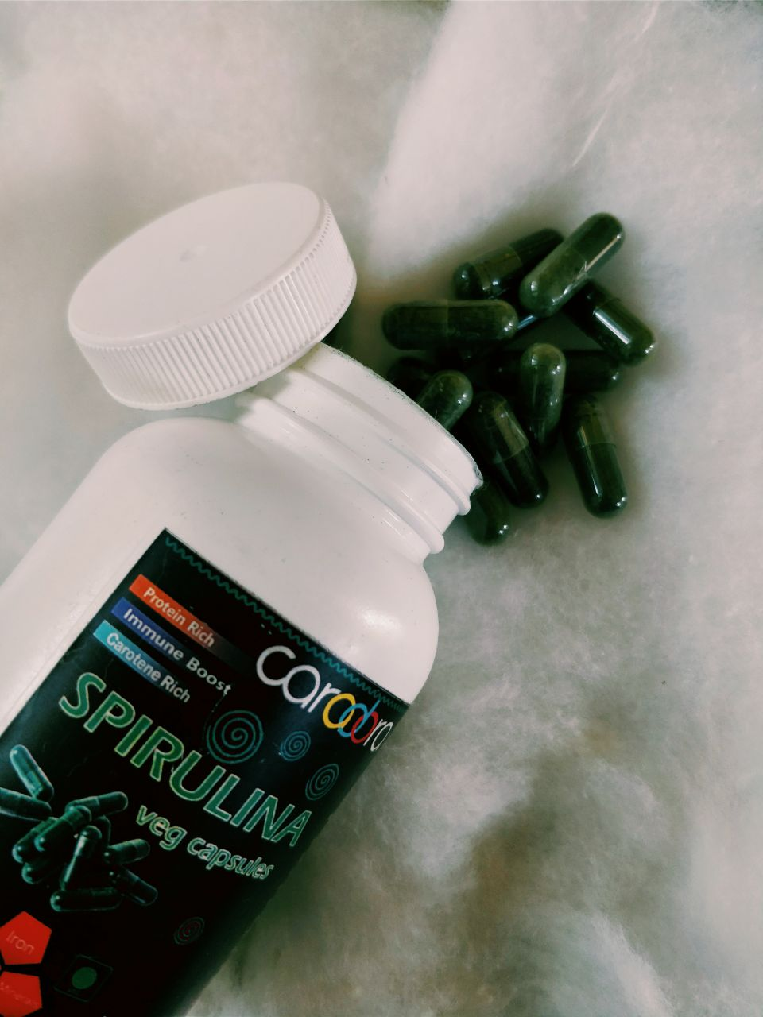

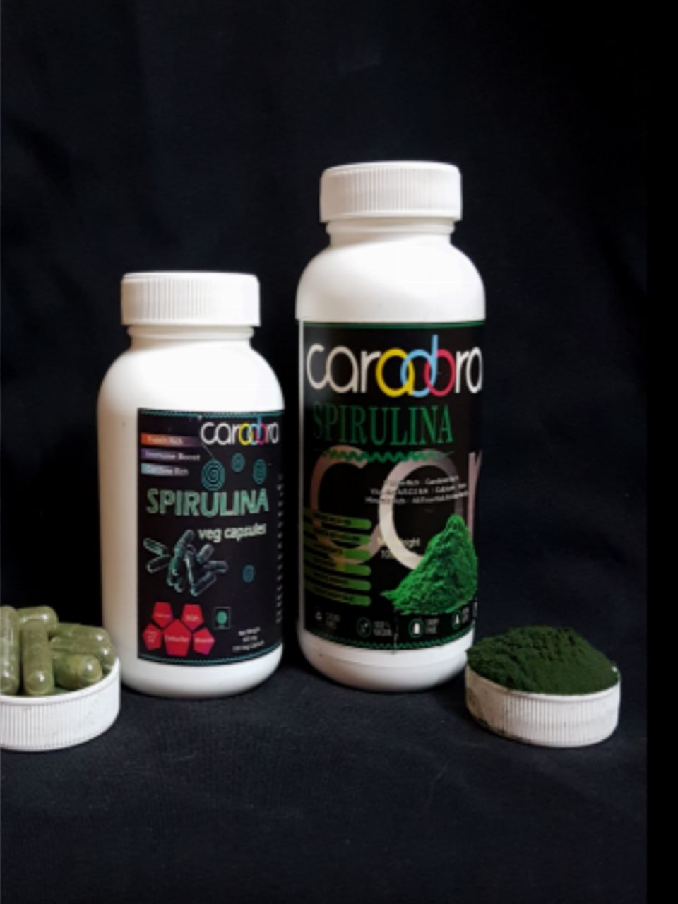
Caradora Spirulina

Slide 5
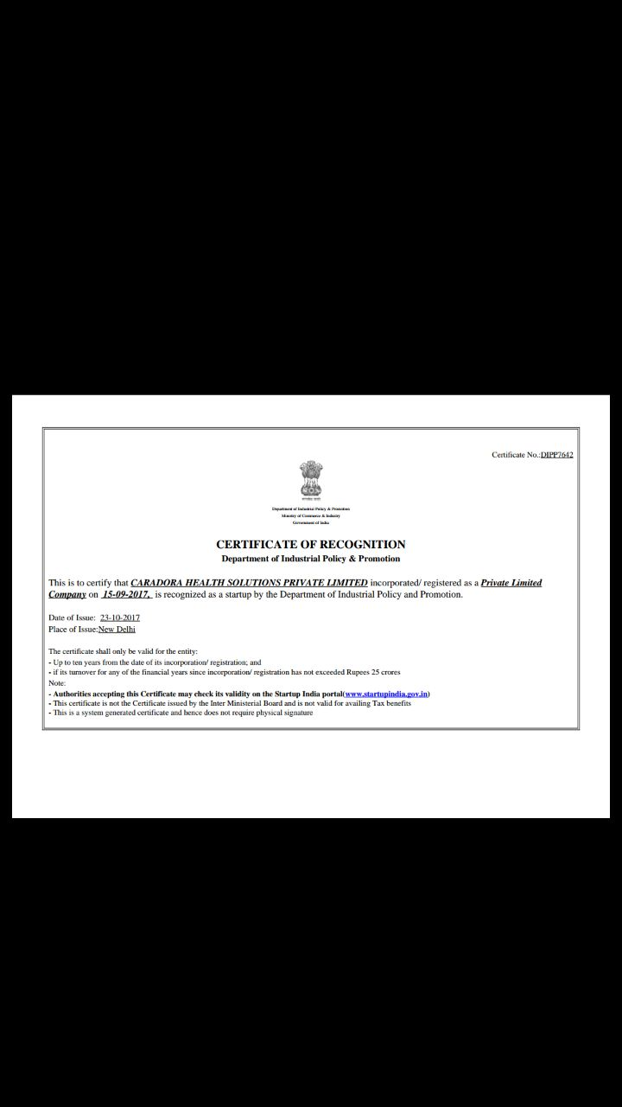
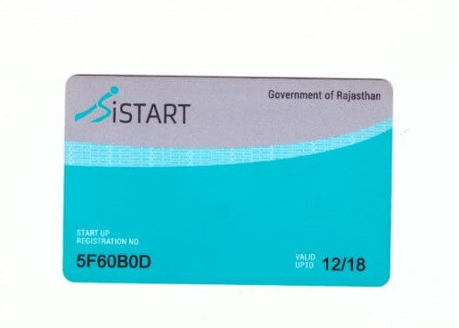
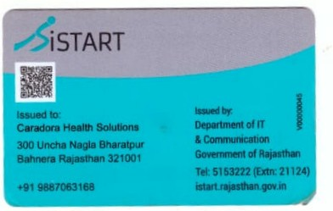

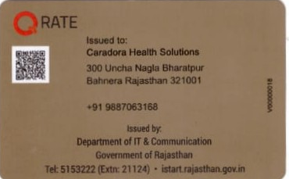
Caradora is among few startups recognized by DIPP, (Govt' of India) and iStart , (Govt‘ of Rajasthan) .

Slide 6
Algae Product Market
Market :-
The algae products market was valued at USD 3.78 Billion in 2017; this is projected to grow at a CAGR of 5.4% to reach USD 5.17 Billion by 2023.
Products :-
Lipids , carrageenan , carotenoids , Alginate and algal protein, Biofuels ,Biodiesel etc.
Applications :-
Food & Beverages , Nutraceuticals & Dietary supplements , Personal care , Feed & Pharmaceuticals.

Slide 7
Caradora Farms
We are joining hands with farmers ,investors, SHGs , Non-Profits & Govt' agencies for Spirulina cultivation project, where We agree to purchase any spirulina they produce using our technology .
Our work for producers :-
Fertilizers & Raw material
Technical support
Free training & learning programs
Brand name & hoarding
Marketing Support
Minimum documentation
Processing & packaging
Quality Test
Algae Laboratory
Mobile Laboratory

Slide 8
Non Profits and Govt' Agencies
Caradora Hunger Project
Processing
Lab Analysis
Quality Control Program
Transportation
Products
Caps, Tabs etc
Packaging
Distribution
Supply Chain
Loading Unloading
CARADORA FARMS
CARADORA OUTLET
Site layout
Skilled Manpower
Training & Learning
Fertilizers & Raw mat.
Cultivation
Harvesting
Drying
Marketing
Branding
Sales
Promotions
CRM
Helpdesk
Pharma companies
Biotech Industry
Nutraceutical companies

Slide 9
Caradora Outlet
B2B
B2C
More than 25 products have been made with the help of Spirulina..
Powder
Capsules
Tablets
Chocolate
Biscuits
Energy Drinks
Shampoo
Face Wash
Face Mask
Ice Cream
Bio-fuels
Bio ink
All Gym Centers
Beauty Parlors
Bakery Shops
Juice bars & Cafe
Grocery Stores
Medical Shops
Doctors & Hospitals
Cancer patients
Asthama & blood sugar
HIV/AIDS
Online Orders
Any Individuals
Amazon, Flipkart & GEM

Slide 10


Billing and accounting support
Brand hoarding
Certified
Hand holding support for six months
Digital marketing
Caradora Outlet
SOCIAL MEDIA MARKETING
Facebook
Twitter
Instagram
Whatsapp
Pinterest
LinkedIn
Youtube
Google
go4Worldbusiness

Slide 11
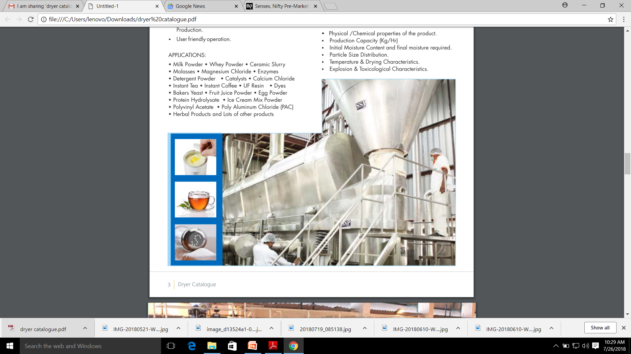

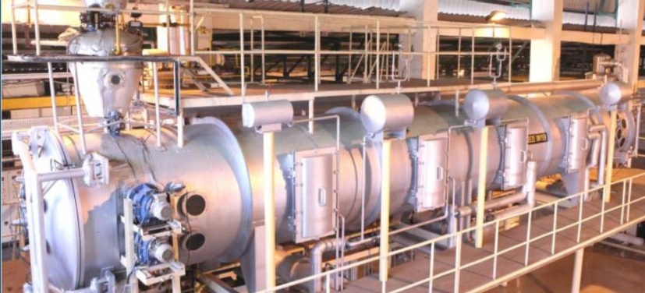
USE OF FINANCE
Hiring People
Training ,Learning & academics
Raw material & Fertilizers
Upgrading of equipments
Algae Laboratory Setup
Transportation
Loading Unloading
Packaging , Biopackaging
Products (Caps, Tabs,etc)
Office Equipments
Stationery
Industrial Dryers(Spray dryer, Freeze dryer,Vaccum dryer etc.)
Marketing
Promotions
Factory/Boundary wall
Billing & Accounting
Certifications & IPR
Working Capital
Vehicle for transport
Installation of Machineries

Slide 12
SPIRULINA : Supporting the Environment
Spirulina is one of the most environmentally efficient crop. Spirulina produces 20 times more protein per acre than common crops such as beef ,corn & soybean while using 10 times less water.
Reduces Carbon Footprint .
Clean Energy : Spirulina & other micro algae can be used to produce renewable bio-fuels, that is future of Global Technology.
Treatment of Nuclear waste
Conserves Water - Unlike fruit & veg that constantly need watering , Spirulina grows on a set amount of water avoiding unnecessary water consumption.

Slide 13
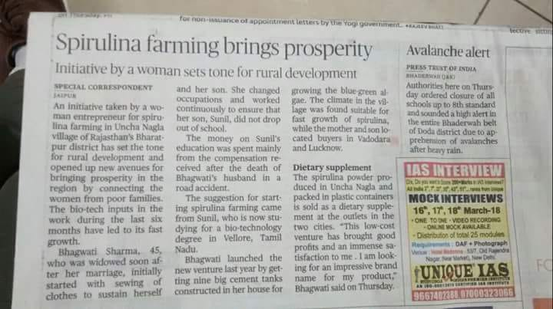
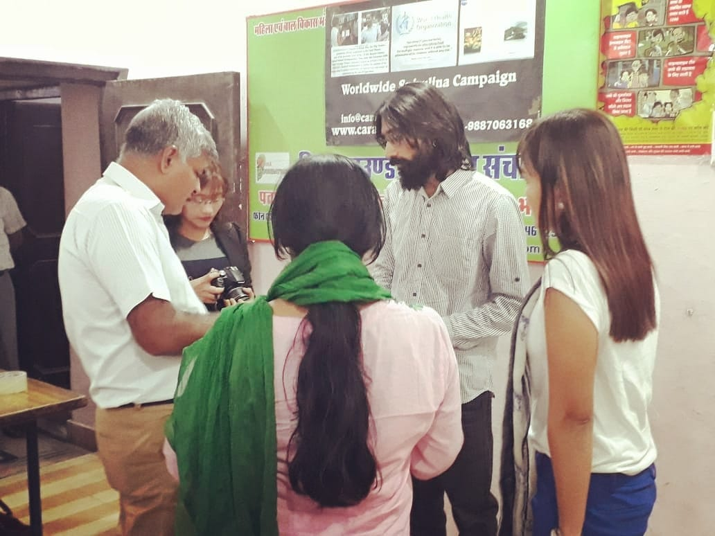
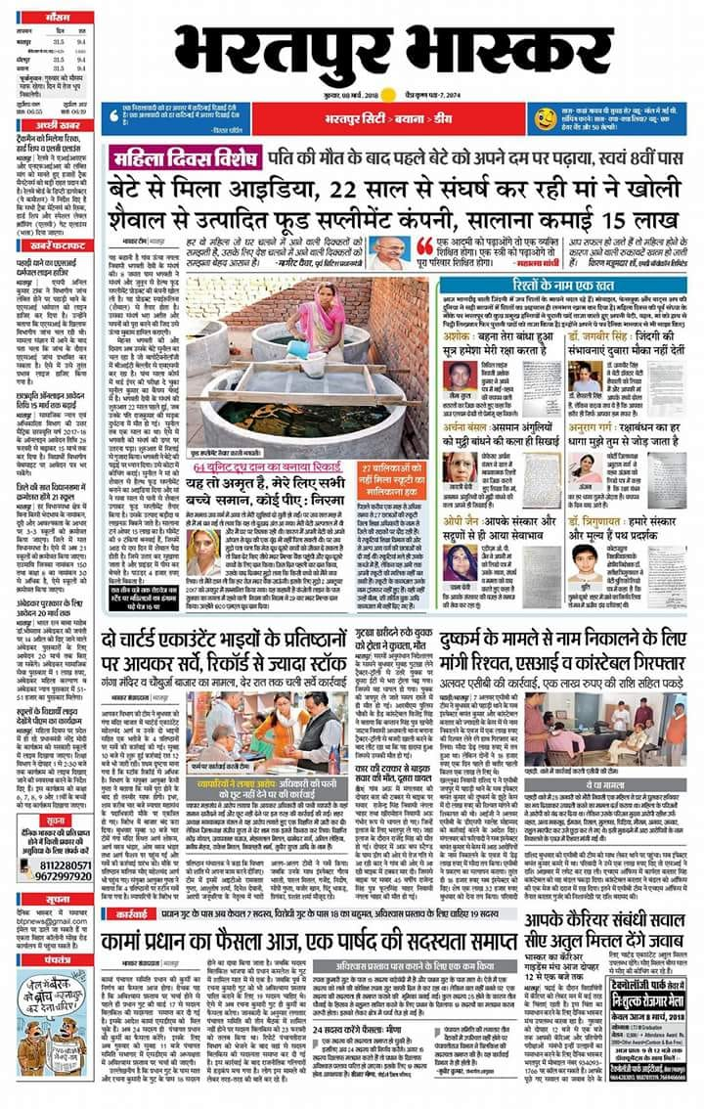
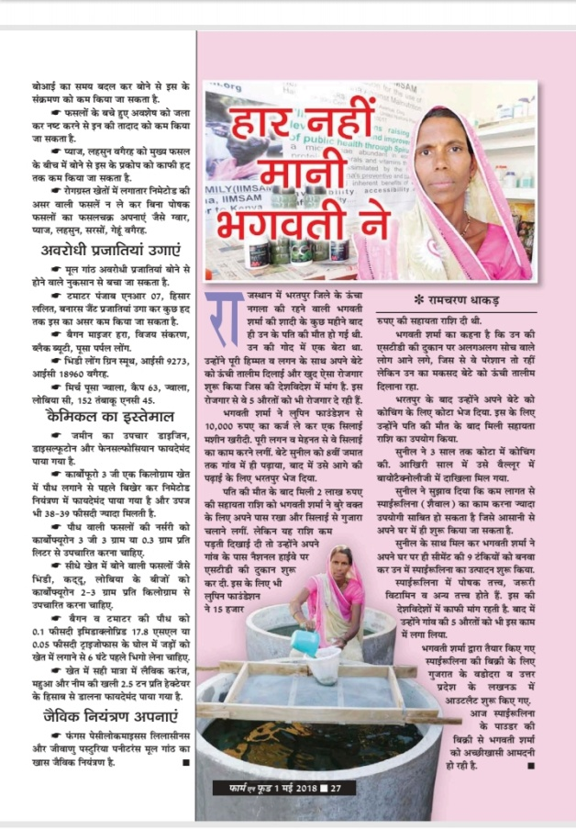
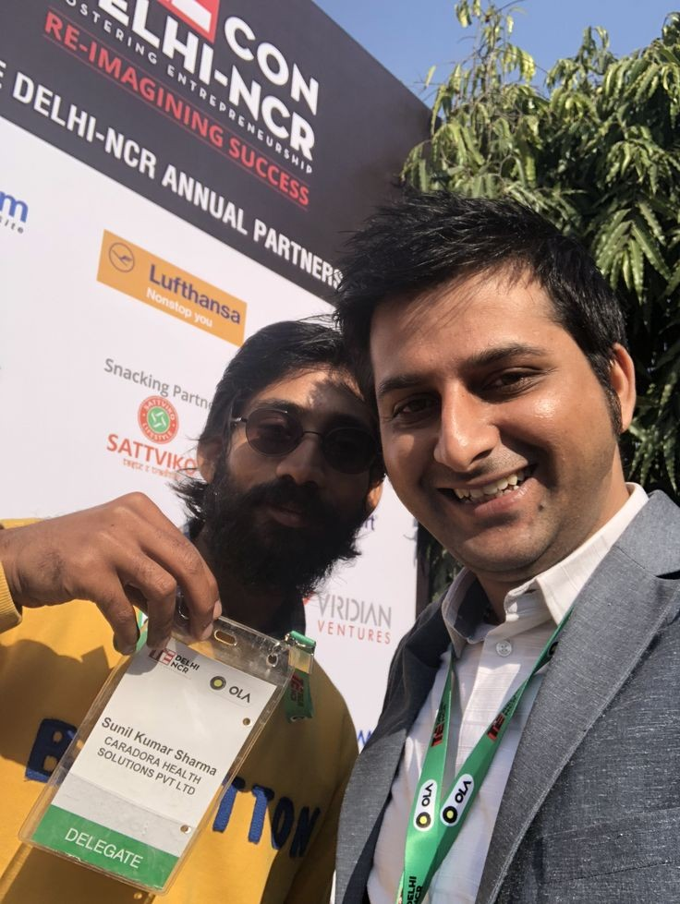
MEDIA & GALLERY

Slide 14


